Slide 1
Introduction to cluster computing on Iridis 5

Slide 2
Administrative
Fire Alarms/exits/toilets
Coffee break
Phones
Handouts

Slide 3
Tutorial Objectives
By the end of this training course, participants will be familiar with:
Iridis 5 cluster structure and hardware (GPUs)
How to find your software
Different job types
Slurm environment: how to
submit
monitor
delete
a batch job on Iridis

Slide 4

Meetoo: www.meetoo.com meeting ID: 169-283-231

Slide 5
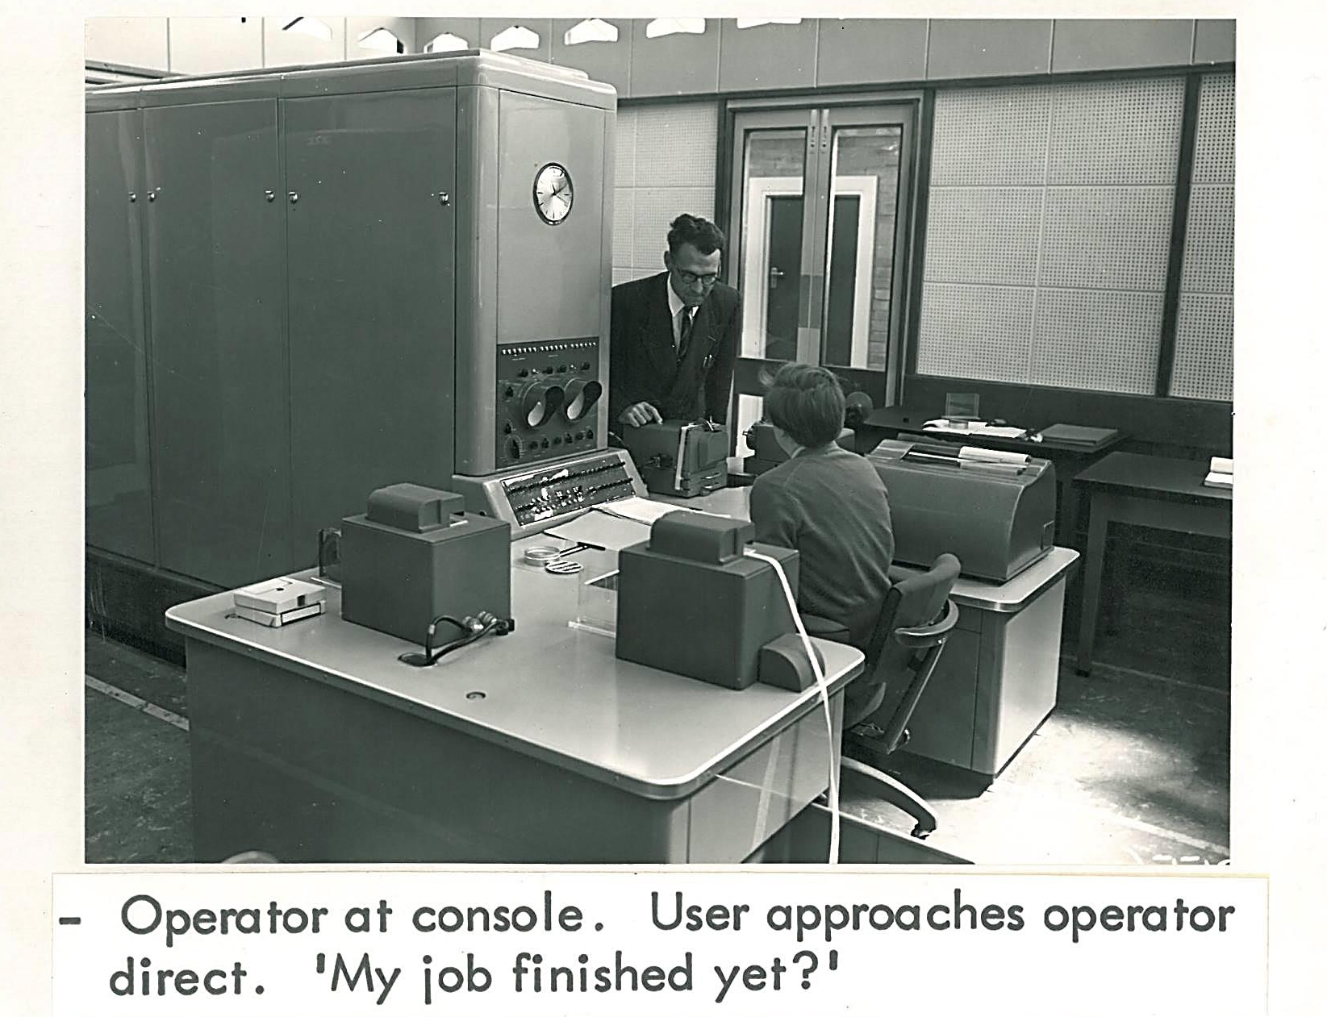
History of HPC in UoS
Notes:
Please use the dd month yyyy format for the date for example 11 January 2008. The main title can be one or two lines long.

Slide 6

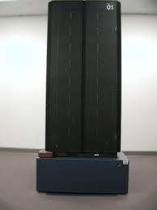
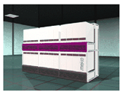
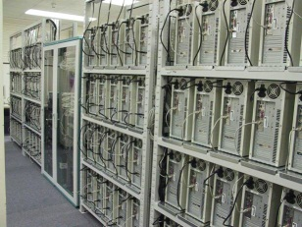

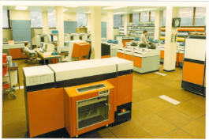
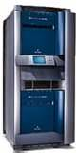

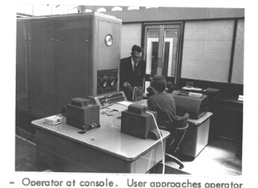
HPC @ Southampton
Meiko CS2
Origin 2000
(1990’s)
Pegasus (1950’s)
ICL (1960’s & 70’s)
IBM3090 (1980’s)
IBM SP2 (1990’s)
Iridis 1-5
(2001-present)

Slide 7









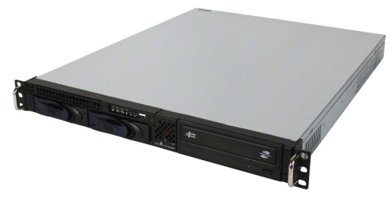
Anatomy of HPC cluster
Interconnect – as fast as possible
Storage – as much as possible
Compute nodes – as many as possible
Software
Few management and login nodes
Happy users

Slide 8






Iridis 5: components
~ 500 compute nodes
3 login nodes:
iridis5_a
iridis5_b
iridis5_c
FDR infiniband
Resource manager,
scheduling engine
(Slurm)
2.2 Petabytes

Slide 9






Cluster component - admin prospective
High speed storage (and servers)
Login nodes
High speed switches connect everything
Uni network
Compute nodes
management nodes

Slide 10

Iridis 5 specifications
#251 in the world (based on July 2018 TOP500 list) with R_{peak} ~ 1,305.6 TFlops/s
464 2.0 GHz nodes with 40 cores per node, 192 GB memory
10 nodes with 4×GTX1080TI GPUs, 28 cores (hyper-threaded), 128 GB memory
10 nodes with 2×Volta Tesla GPUs, same as standard compute
2.2 PB disk with parallel file system (>12 GB/s)
£5M Project delivered by OCF/IBM
http://www.top500.org/

Slide 11
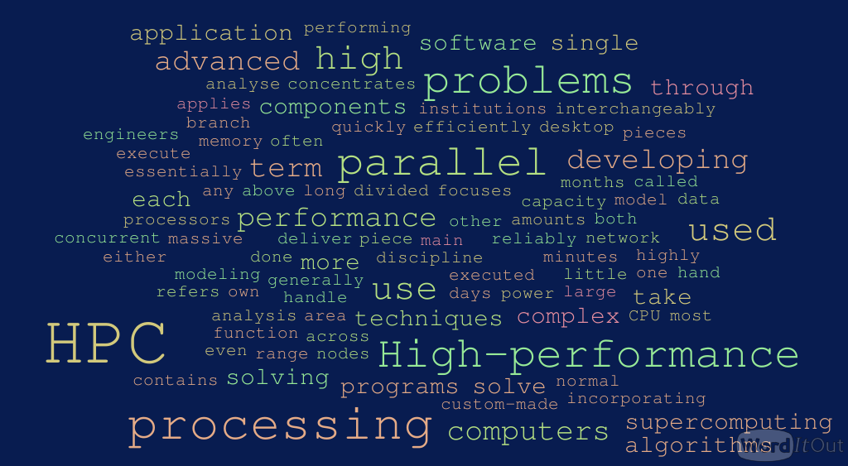
High Performance Computing =
The term High Performance Computing (HPC) refers to any computational activity requiring more than a single computer to execute a task.

Slide 12
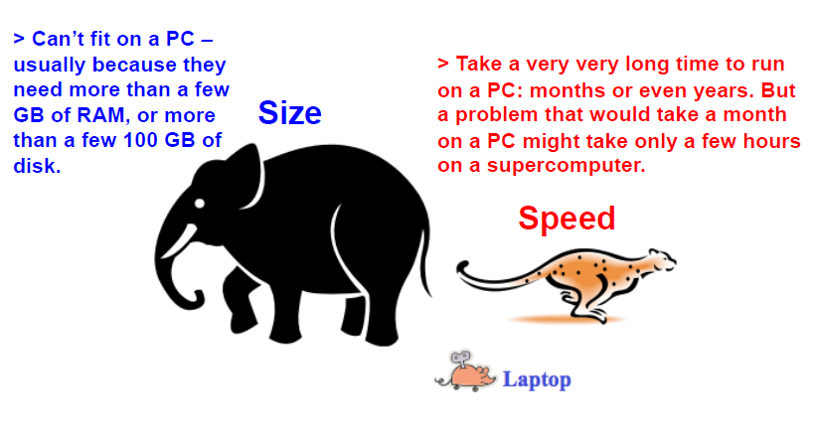
Typical HPC problem…
From Jason Shih

Slide 13

Why Linux?
COST - Linux is (mainly) free
STABILITY – made to keep on running
MULTITASKING multi-user, multitasking environment
(almost) Free from Viruses
very well-protected — but not immune
Knowledge of Linux will expand your employment horizons

Slide 14
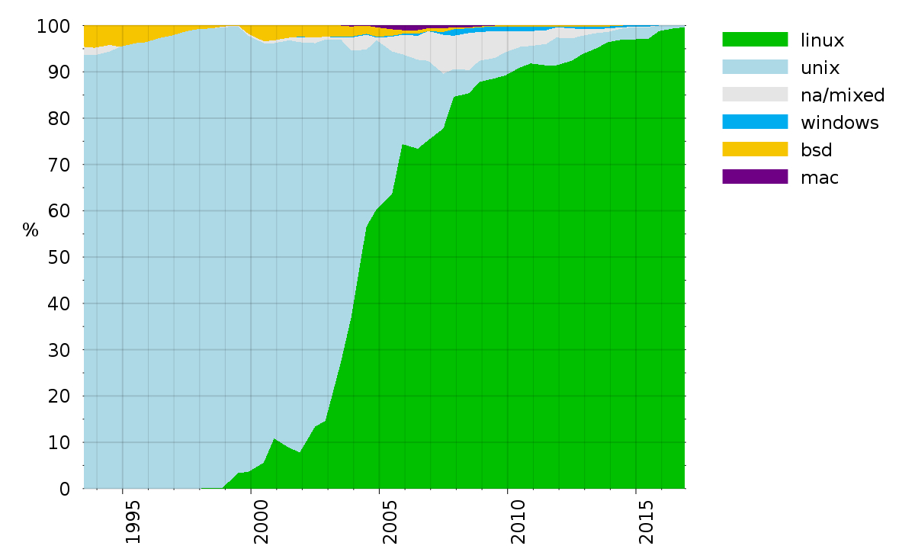
Linux on supercomputers

Slide 15

Linux: brief history
Linux is a variant of Unix
So is Mac OS, so much of this tutorial applies to Macs as well
Linux is open source software
The name “Linux” comes from the Linux kernel, originally written by Linus Torvalds in 1991 (at the age of 22!) Linus+Unix=Linux
More then 200 Linux Distributions http://distrowatch.com/

Slide 16


Slide 17


Slide 18
High-performance computing is really different. No matter what you have learned about coding, using HPC clusters takes a whole new skill set.

Slide 19

Getting ready to roll
Notes:
Please use the dd month yyyy format for the date for example 11 January 2008. The main title can be one or two lines long.

Slide 20

know your neighbour!

Slide 21
Using Iridis: Security
Boring but very, very important
our IT infrastructure is under constant attack by would-be intruders
Your data and research career is threatened by intruders
Big systems are big, juicy targets
Don't let intruders in:
Keep your password (or private key passphrase) safe.
Choose a strong password.
Keep the software on your laptops/tablets/PCs up to date.
Don't share accounts (this is against the rules anyway).

Slide 22
Connecting to Iridis: SSH
Usually available out of the box on Linux or MAC
$ ssh –Y abc123@iridis5_a.soton.ac.uk
Windows clients:
MobaXterm
SSH client (Putty) + X Server (Exceed)
Ubuntu for Windows
https://tutorials.ubuntu.com/tutorial/tutorial-ubuntu-on-windows#0
No official support for graphical windows but it can be done
Need to be on internal network or use VPN

Slide 23
Do you have any experience with CLI?
1.
Yes - loads!
2.
Yes - some
3.
No
4.
Don’t remember

Slide 24

Lynda courses on Linux:
Learning Linux Command Line 1h 43m
Learning Bash Scripting 1h 25m
Linux Tips Weekly 36m 26s

Slide 25
Software Carpentry
https://software-carpentry.org/lessons/
A popular set of courses covering a variety of computing and programming topics
Even a new and experimental HPC course – not directly translatable to our setup but still some good content
https://epcced.github.io/hpc-intro/

Slide 26
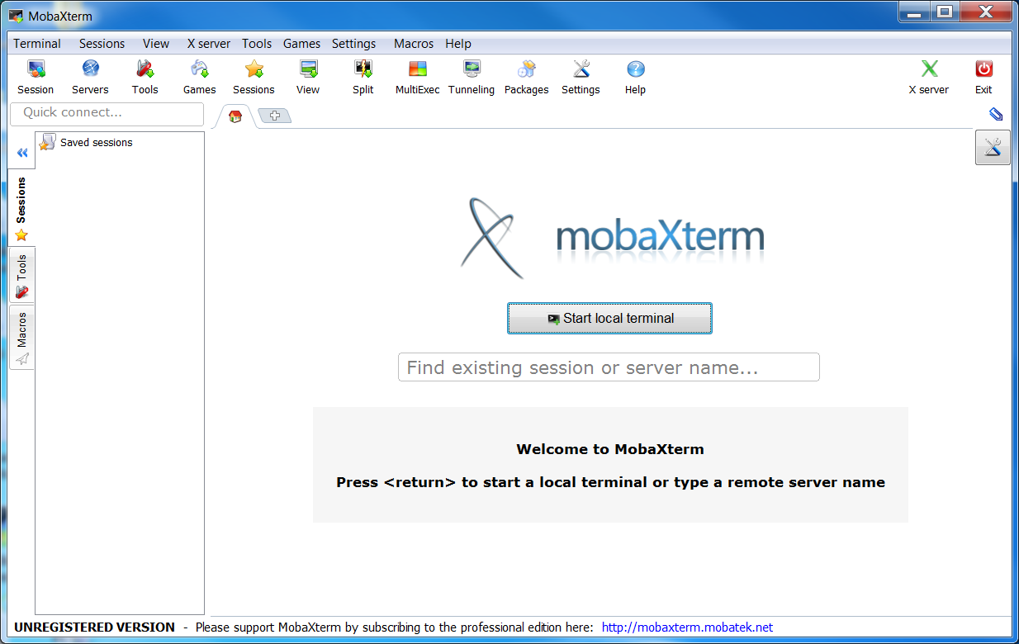
SSH client - MobaXterm
http://mobaxterm.mobatek.net/
Go to Download – Portable edition

Slide 27
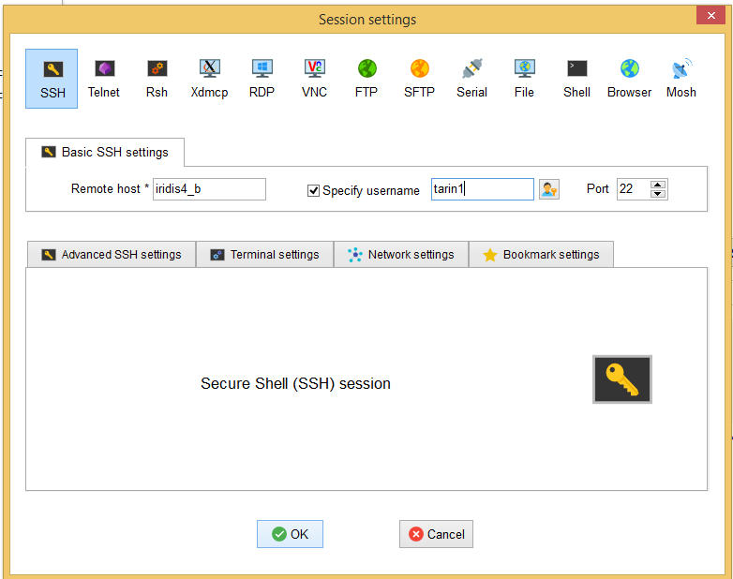
Login to Iridis
Start ssh client MobaXterm
Go to Sessions -> SSH
Remote host =
iridis5_a
Iridis5_b
Iridis5_c
Use your iSolutions username/password
Press OK
You may want to save password
Try to log out (“exit”) and login again
The authenticity of host 'iridis5_b (152.78.188.134)' can't be established.
RSA key fingerprint is 01:60:2d:58:1b:24:05:e9:a2:d6:17:3b:25:c5:be:ef.
Are you sure you want to continue connecting (yes/no)?

Slide 28
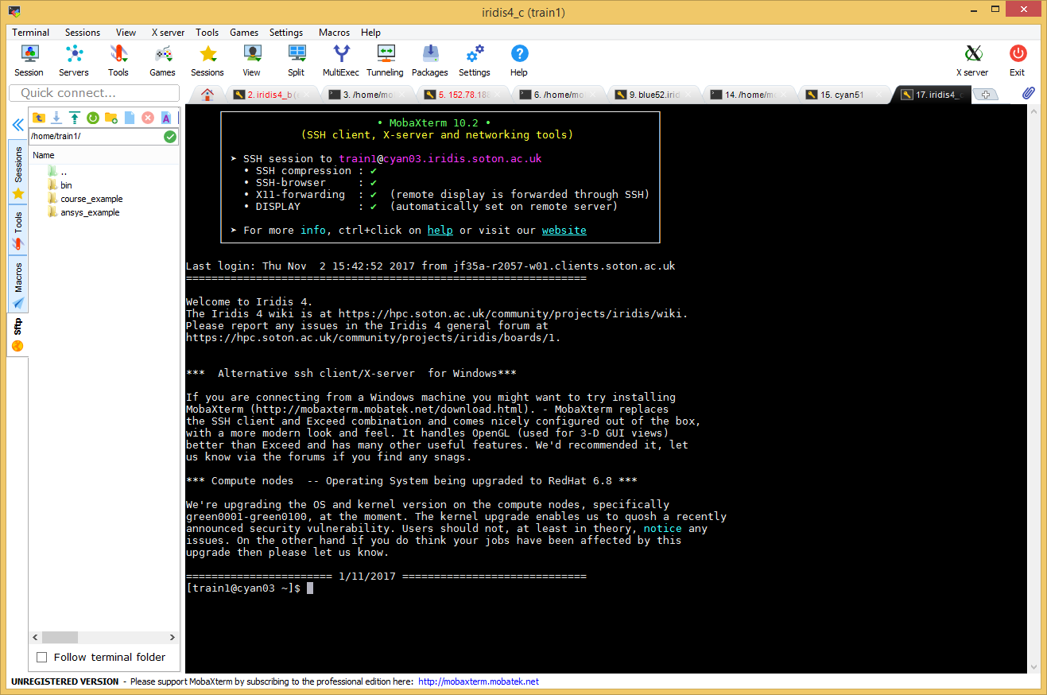
MOTD= Message Of The Day
Read latest system announcement/status/news
Notes:
Use cat /etc/motd to view at any time

Slide 29
What is a command shell?
After logging in, Linux starts a program called the shell
This program interprets user commands
Allows a user to execute commands by
typing them manually at a terminal
automatically in programs called shell script
Shell commands are CASE SENSITIVE !

Slide 30
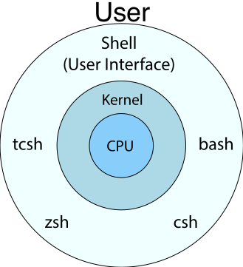
Linux SHELL
CLI vs GUI
Many SHELL flavours –
Iridis uses bash
$ = command prompt
[train1@cyan01~]$
Try your first Linux command:
$uname
$uname –a
$whoami
Notes:
Computer interface – keyboard, mouse, touchpad
Show bash, tcsh, echo $0

Slide 31
Linux command
Command prompt
$ ls –ltr /tmp
Command name
Arguments
Options (flags)

Slide 32
Help!
Whenever you need help with a command type
“q” to quit man
There are 1000s of commands available – can’t possibly learn them all!
Almost every command has a numerous switches to use
Another useful commands:
$ info command_name
$ command_name --help
$ man command
$ man man

Slide 33

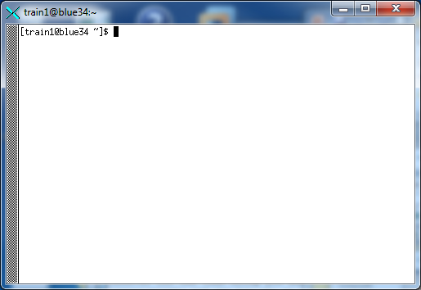
Exercise I
Login to one of Iridis login nodes
Try to open an X-window connection by typing
$ xclock &
Log out
Login again using saved profile
Open a new window by typing
$ xterm &

Slide 34
Control Characters
You type Control characters by holding down the <Ctrl> key while also pressing the specified character.
Control commands:
<Ctrl>-c will abort any program
<Ctrl>-d “exit”
<Ctrl>-z pauses (stops) an on-going operation
Use fg to bring your process back
Use Up/Down arrow keys to scroll through your command history
Linux Can Even Read Your Mind!
<Tab> button completes commands and filenames

Slide 35
File structure
The Linux file system is a tree-like hierarchy.
The top level directory is called the root directory – special meaning of “/”
Your home directory is the directory you are in when you first open the terminal.
The full path to a Linux directory or file is the series of directories, starting at the root
/ (aka root)
/bin
/local
/tmp
/home
/var
/user1
/user2
/user3
/data
/docs
/work
Notes:
Definition of “full path”

Slide 36
Navigating the file system
To find your current directory: $ pwd
To change to a specific directory: $ cd dir_name
To return to home directory: $ cd ~
Try:
$ pwd
$ cd /scratch/<train1>
$ cd ~
$ pwd

Slide 37
Starting from /scratch/amanda, which of the following commands could Amanda use to navigate to her home directory, which is /home/amanda?
1.
$ cd .
2.
$ cd /
3.
$ cd /home/amanda
4.
$ cd ../..
5.
$ cd ~
6.
$ cd home

Slide 38
Wildcards
You can replace any number of characters in any filename by *
If you type just * after a command, it stands for all files in the current directory:
$ ls *
You can mix the * with other characters to form a search pattern:
$ ls /tmp/a*.txt
The “?” wildcard stands for any single character:
$ rm draft?.txt will remove files draft1.txt but not draftFinal.txt

Slide 39
Which of the following statements is TRUE:
Vote for up to 7 choices
1.
Up/Down arrays allow me navigate my command history
2.
<Ctrl>-c - send running process kill signal
3.
<Ctrl>-d - will close my current session
4.
<Ctrl>-z – similar to <Ctrl>-c
5.
$cd / will always bring me home
6.
$rm * will move all files and subdirectories to Recycle Bin
7.
$cd /sc<Tab> will bring me to scratch directory

Slide 40
Connecting commands with pipes
$ who | wc -l
Takes this input and counts the number of lines
Shows who is logged on
“Pipe”: Takes output of the who and sends it to next command

Slide 41
Redirection
Most of processes write to the standard output (terminal screen) and many take input from the standard input (keyboard)
There is also the standard error for error messages (terminal screen by default)
“>” redirects the output:
$ tree > full_list
$ cat full_list
“>>” appends standard output to a file
“<” redirect the input

Slide 42
Using variables in bash
$ i=1
$ echo $i
Declare the variable ‘i’ and set its value.
Print input to screen
Access variable with $varname. Don’t confuse with the prompt!
Bash does not like spaces
All variables are strings!

Slide 43
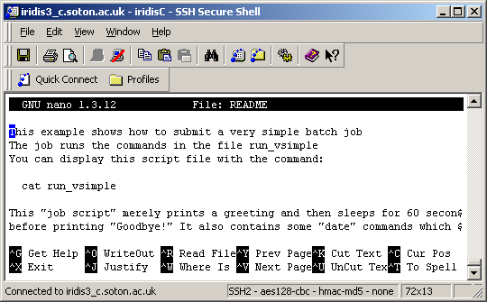
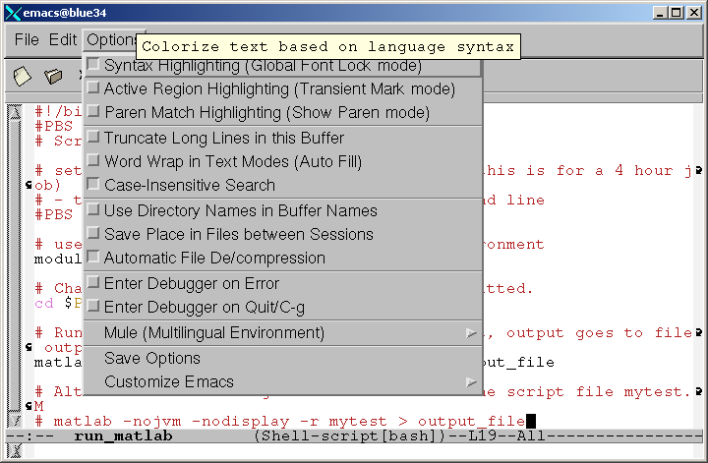
Creating and editing files
Suggested editors:
nano (for small edits)
emacs (for code development)
vi (for advanced text editing)

Slide 44


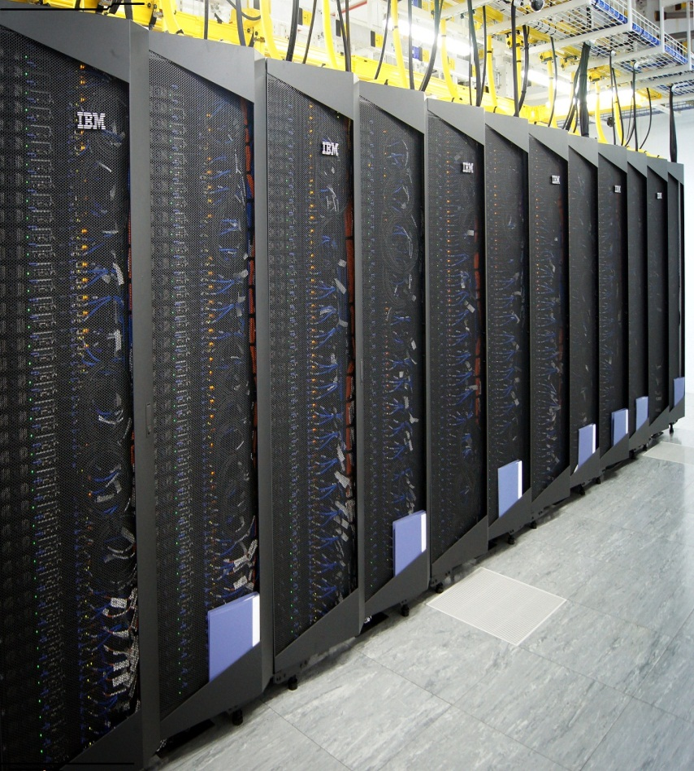
Introducing Iridis 5
Notes:
Please use the dd month yyyy format for the date for example 11 January 2008. The main title can be one or two lines long.

Slide 45



New user kit
/home 130 GB (backed up)
/scratch 2 TB
~X GTX1080Ti's at once
Software
Notes:
Home-work-temp 40-100-500
mdiag -u DEFAULT
MAXJOB=512,768 MAXNODE=64,96 MAXPROC=512,768 MAXPS=82944000,124416000 MAXIJOB=32 MAXIPROC=576,1024 MAXIPS=100000000

Slide 46
GTX1080TI node (pinkNN): 28 CPU cores (hyperthreaded), 128 GB, 4 GTX1080TI's
Mother Board
GTX1080Ti
GTX1080Ti
GTX1080Ti
GTX1080Ti
Intel Xeon E5-2680 v4
Intel Xeon E5-2680 v4
Core 0
Core 1
Core 0
Core 1
Core 2
Core 3
Core 2
Core 3
Core 4
Core 5
Core 4
Core 5
Core 6
Core 7
Core 6
Core 7
Core 8
Core 9
Core 8
Core 9
Core 10
Core 11
Core 10
Core 11
Core 12
Core 13
Core 12
Core 13
128 GB DDR4 Memory

Slide 47

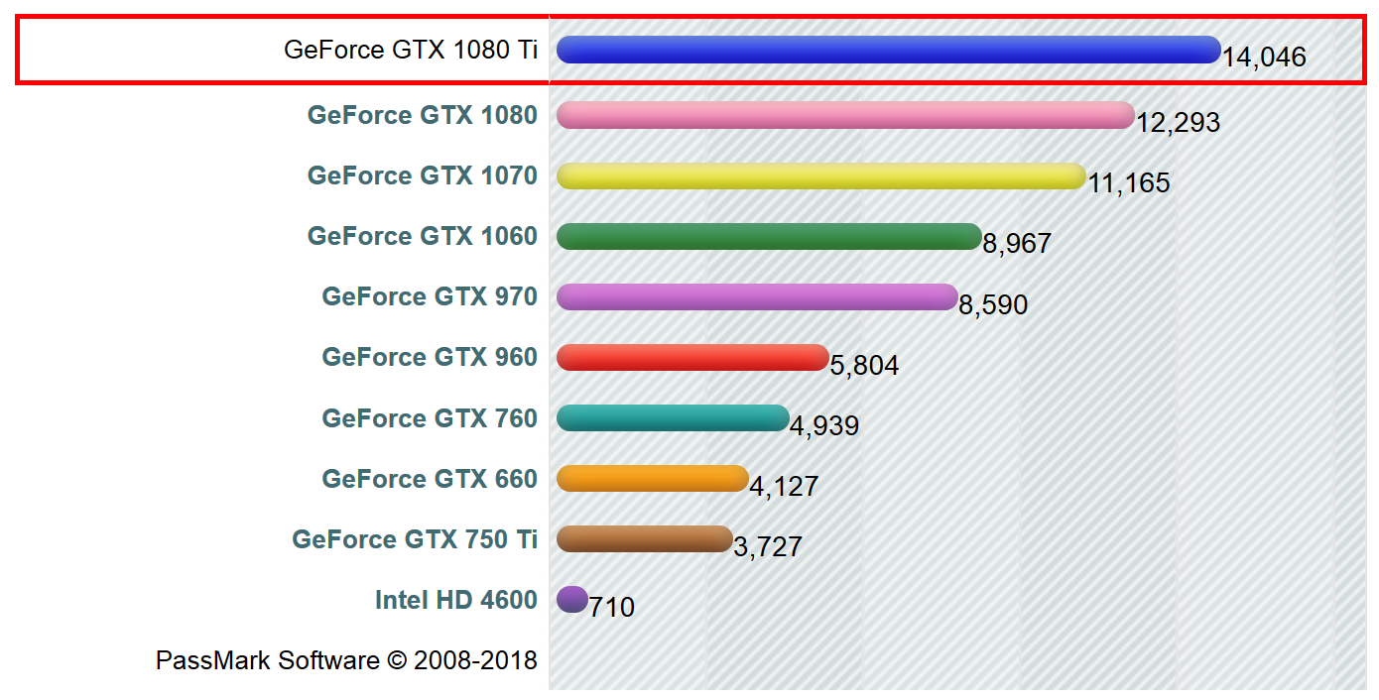
GTX1080TI: Vital Statistics
3854 CUDA Cores
Clock speed of 1.6 GHz
11 GB Memory
Dual PCI Express Connection

Slide 48

Iridis File System
/home
/scratch
daily backup
NEVER backed up
/home/user/
File system | Size | Files
/home | 130 GB | 200 000
/scratch | 1500 GB | 600 000
/scratch/user/
$ mmlsquota --block-size g mainfs:lyceum
Notes:
Home-work-temp 40-100-500
mdiag -u DEFAULT
MAXJOB=512,768 MAXNODE=64,96 MAXPROC=512,768 MAXPS=82944000,124416000 MAXIJOB=32 MAXIPROC=576,1024 MAXIPS=100000000

Slide 49
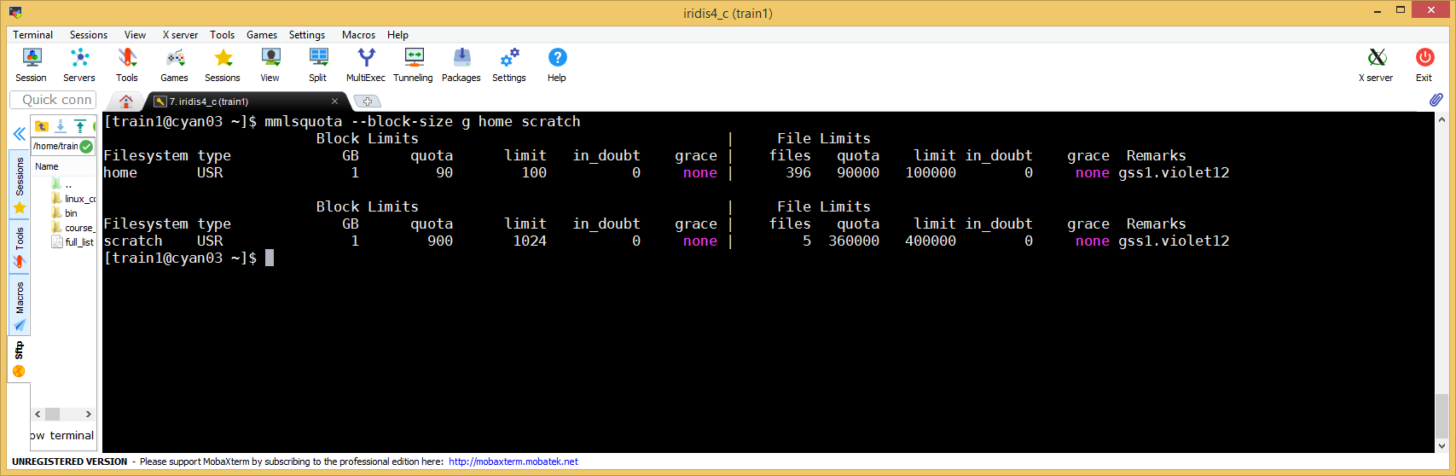
Filesystems: Quota
$ mmlsquota --block-size g mainfs:lyceum mainfs:scratch
Aim to stay below the soft limit (quota)
Once over the soft limit, you have 30 days grace to return below

Slide 50
Which of the following statement is true:
Vote for up to 6 choices
1.
It’s better to keep your research data in /scratch then in /home because /scratch quota is 10 times bigger;
2.
If I exceed my quota in both scratch and home I will not be able to login to Iridis;
3.
I can keep as many files as I want in my home directory as long as their total size is under 100GB;
4.
I will get email notification when I am close to my quota;
5.
Once grace period is over, I need to shrink my files under quota to be able to use my allocation;
6.
All Iridis storage is backed up: /home is backed up every day and /scratch - once per month;

Slide 51
Software Environment Management - Modules
A module system is used to manage the software on Iridis 4
Try:
$ module av[ail]
$ module li[st]
$ module help matlab
$ module load matlab
$ module show R/3.4.3
$ module load R
$ module --help

Slide 52

How to use cluster?
Few easy steps:
Connect to Iridis
Determine required software
Transfer input files & source code
Compile programs (if needed)
Test software/programs
Write submission script
Submit batch jobs
Get results, complete project and get MSc!

Slide 53

Managing Batch Jobs
Notes:
Please use the dd month yyyy format for the date for example 11 January 2008. The main title can be one or two lines long.

Slide 54
Jobs
Job = request for resources for a period of time
Different types of jobs:
Batch vs. interactive
batch = does not require user’s interaction
interactive = useful for testing codes, scripts & input, using graphical interfaces (GUI)
Serial vs. parallel
Serial = job requires only one processor for execution
Parallel = job requires more then one processor for execution, probably over multiple nodes
Notes:
Need a parallel application to take advantage of multiple processors!

Slide 55
Job Management System
Resource manager: Slurm – manages jobs
Job scheduler: Slurm – decides what jobs run and when
Fairness between users (but it’s not easy)
Optimizes cluster node utilization
User interface for submitting and monitoring jobs
A submission script is used to tell the resource manager the resources required, how to run the job

Slide 56
Specifying job resources
My Job
How many CPUs? Memory?
For how long?
What software?
Where are input files?
Where to save output?
Licence?

Slide 57
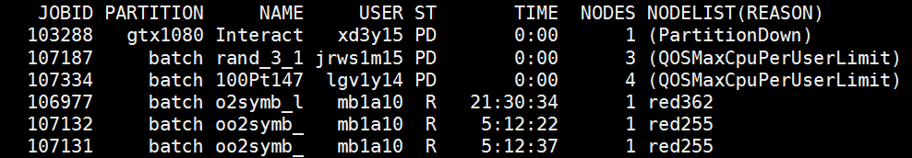
Job state – how to check it
Running (R)
Completed (C)
Pending (PD)
Slurm will tell you why!
No free nodes (Priority)
You’re at your usage limit (QOSResourceLimit)
man squeue will explain reasons
All jobs:
$ squeue
$ squeue | less
$ squeue –l | less
Your jobs:
$ myqueue
IMAGE OF QUEUE STATE HRE

Slide 58
Job Submission: sbatch
Submits batch job defined in script
Returns job ID used for job management
Syntax
Options – job description options, equivalent to options in script (command line take precedence)
Each job produces 2 files with output & error messages, jobname-<jobid>.out & jobname-<jobid>.err
$ sbatch [options] <job_script>

Slide 59
Job Submission: partitions
Different resources are accessed through Slurm partitions
Multiple partitions are configured on Iridis
You will have access to only one - lyceum
Provides access to GTX1080s (pink nodes)
Higher priority, lower resources
$ sbatch -p lyceum [options] <job_script>

Slide 60
Anatomy of a job script
#!/bin/bash
#SBATCH --time=00:30:00
cd $SLURM_SUBMIT_DIR
# Say hello to the user
echo "Hello $USER“
sleep 30s
echo "Goodbye $USER“
Important things to remember:
All lines starting from
#SBATCH
…..are called Slurm directives
Slurm will scan all the initial comment lines for Slurm directives until the first executable line. Any directives embedded in the script after some executable lines will be ignored.
=> This is a bash shell script
=> Job requirements
=> Change to job submission dir
=> This is a comment
=> Linux commands
=> Do nothing for 300 seconds!
=> Job finishes after printing this

Slide 61
Anatomy of a job script
#!/bin/bash
#SBATCH --job-name=NAME
#SBATCH --time=00:30:00
#SBATCH --nodes=1
#SBATCH --gres=gpu:1
#SBATCH --ntasks=14
#SBATCH -p lyceum
Important Slurm directives:
A name for the job. Will show up in squeue
Length of job to request
How many nodes. Probably one…
Number of gpus to request. Probably one…
Partition to run the job in

Slide 62
Let’s try an Interactive Job:
To request an interactive session:
Start an interactive job and
Note node name: pinkNN as opposite to cyan5N
Monitor it from another terminal with myqueue
Run on login and compute nodes commands who and compare output
From the login node kill this job with scancel <JID>
You share login nodes with other users – do not run CPU intensive jobs on them! Use batch system instead
$ sinteractive -p lyceum --gres=gpu:1

Slide 63
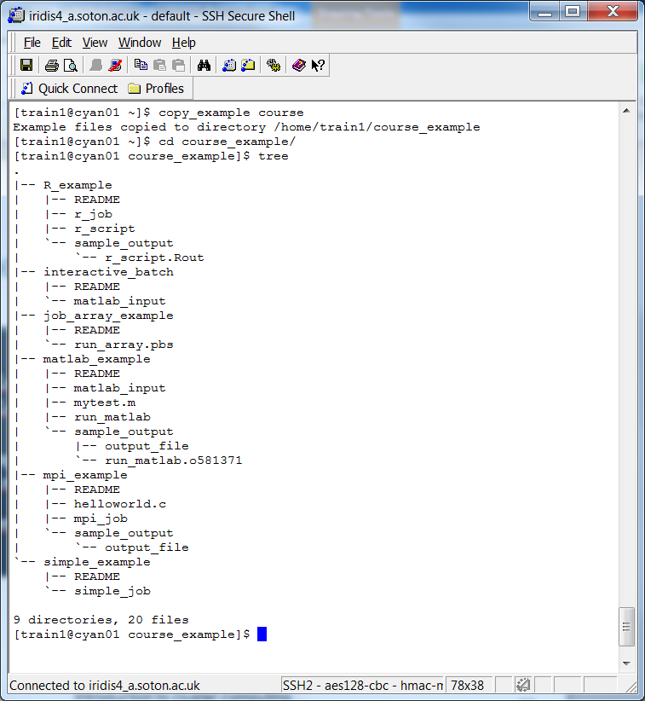
And now practice!
From your home directory on an Iridis 5 head node.
$ copy_example
$ copy_example msc_course
$ cd msc_course_example
There is 1 example and 3 exercises numbered by order.
In each exercise directory there is a README file explaining what to do.

Slide 64
Things to remember
The pink nodes are shared with other users
A single pink node can be shared with other users
Advice: Request a number of CPU tasks in proportion to the number of GPUs i.e. for each GPU ask for 14 CPU tasks
You can access to up to four GPUs at once.

Slide 65
Which of the below Slurm commands will successfully run a job for me?
Vote for up to 4 choices
1.
sinteractive --gres=gpu:1
2.
sbatch -p lyceum job.slurm
3.
sbatch -p lyceum --gres=gpu:1 --time=80:00:00
4.
sinteractive -p lyceum --gres=gpu:1 --ntasks=1 --time=10:00:00

Slide 66
Job Arrays
Best solution when you need to run many very similar jobs (for example process many input files)
Single input script functions as a template
$SLURM_ARRAY_TASK_ID – array index of the job
$ sbatch –-array 0-10 my_job.slurm
$ sbatch --array 100 my_job.slurm
$ sbatch –-array 4-9,12,800 my_job.slurm

Slide 67
Why won’t my job run?
Possible reasons could be:
Submitting to wrong queue – sinfo -l
error in job script => check error file
resource issue => not enough memory?
cluster is full & you’ll have to wait
Iridis is down or in maintenance => check Iridis status page
you have exceeded your disk quota:
$ mmlsquota mainfs:lyceum mainfs:scratch
Notes:
Must be time for tea & coffee!

Slide 68
Few reminders…
Check MOTD for coming maintenance period/known problems
If reporting a problem – provide us with
your job ID
submission script
how to reproduce the problem
Do not run CPU intensive jobs on login nodes.

Slide 69

Tutorial Outcome
By now participants are familiar with:
Iridis 5 cluster components
Basic Linux commands
Software modules
Different job types
Slurm environment: how to
submit
monitor
control
a batch job on Iridis

Slide 70
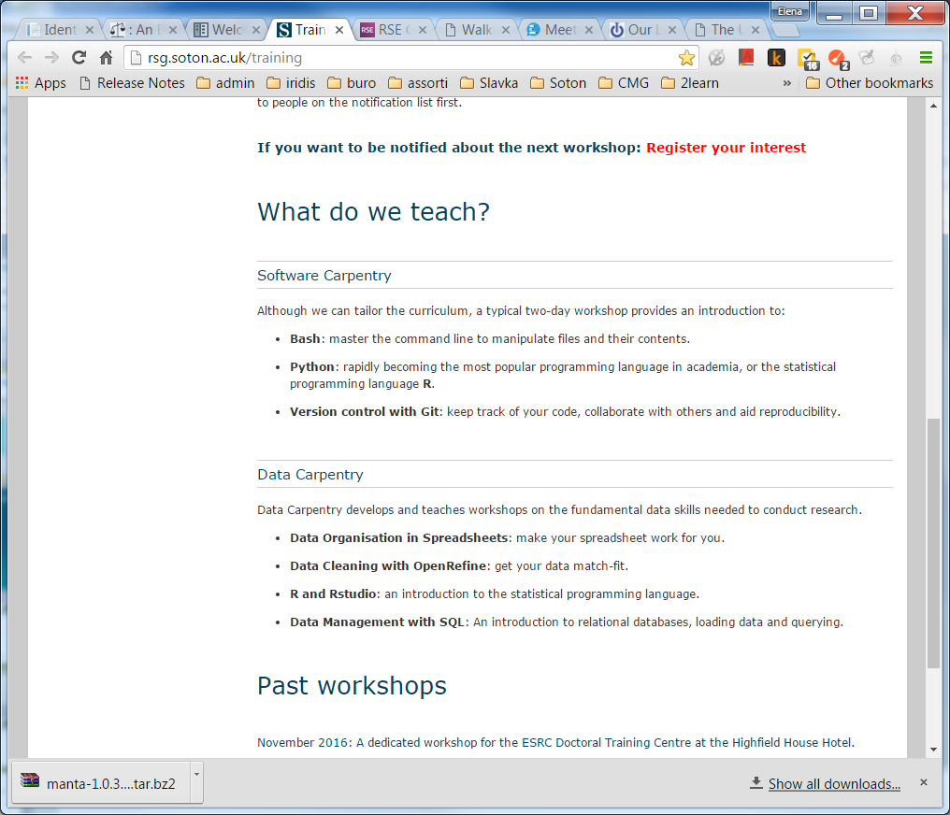
Further training
Ask questions on Iridis Forum
Request training on Iridis forum
Follow one of Software Carpentry courses:
http://rsg.soton.ac.uk/training

Slide 71

Backup
Notes:
Please use the dd month yyyy format for the date for example 11 January 2008. The main title can be one or two lines long.

